Slide 1

Kenya Medical training college
Faculty of Clinical Sciences
Department Of Orthopaedics and Trauma Medicine
General Orthopaedics I
Osteomyelitis
By
Gideon Sifirino
Class: Orthotrauma med

Slide 2
Learning outcomes
By the end of this presentation the learner should be able to;
Define Osteomyelitis
State the microbes causing osteomyelitis
Identify mode of Spread
Describe the Predisposing factors to osteomyelitis
Identify the risk factors
Classify osteomyelitis

Slide 3
Osteomyelitis
The word osteomyelitis is derived from
Osteon (bone) myelo (marrow) itis (inflammation).
It is said to be coined by
Nelaton in the year 1834. Hence
osteomyelitis is defined as:

Slide 4
Cont’d
Inflammation of the bone and the
bone marrow , (Shenoy, 2010).
Infection of the bone and bone marrow
Suppurative process of the bone caused
by pyogenic organisms to the cancellous portion of the bone, (Ebnezer, 2012).

Slide 5
Cont’d
The infection of bone characterized by progressive inflammatory destruction and apposition of new bone.
Infection of bone by pyogenic organisms

Slide 6
Causes
Micro organisms

Slide 7
New-borns (younger than 4 months) | S. A , Enterobacter ssp, group A & B Strept ssp
Children(4 months to 4 years) | S. aureus, group A Strept ssp , Kingella kingae, and Enterobacter species
Children, adolescents (aged 4 years to adult) | S. A (80%), group A Strept ssp , H. influenzae, and Enterobacter species
Adult | S. A ,occasionally Enterobacter or Strept ssp

Slide 8
Salmonella | Sickle cell anaemia patients
Pseudomonas | IV drug use
Bartonella | HIV/AIDS patient, cat scratch or bite
Fungal osteomyelitis | Immunosuppressed, long-term IV medications, or parenteral nutrition
Tuberculosis | Manifestations include Potts disease

Slide 9
Mode of Spread
Haematogenous (commonest):originated or transported by blood.
Contiguous-spread: neighbouring infective sites like septic arthritis
Direct inoculation: penetrating wounds, punctured wounds, trauma.
(Ebnezer, 2012).

Slide 10
Predisposing factors
Age: Common in children and in young
Sex: M: F ratio is 5:1.
Trauma
Location: Metaphysis of a long bone
Poor nutritional status: General debility and malnutrition
Organisms
(Shenoy, 2010).

Slide 11
Risk factors
Recent trauma or surgery
Immunocompromised patients
Illicit IV drug use
Poor vascular supply
Systemic conditions such as diabetes and sickle cell
Peripheral neuropathy
(Shenoy, 2010).

Slide 12
Classification
Timing classification
Acute Osteomyelitis
Within 2 weeks
Sub-acute Osteomyelitis
Within one to several months
Chronic Osteomyelitis
After several months
(www.orthobullets.com, 2022)

Slide 13
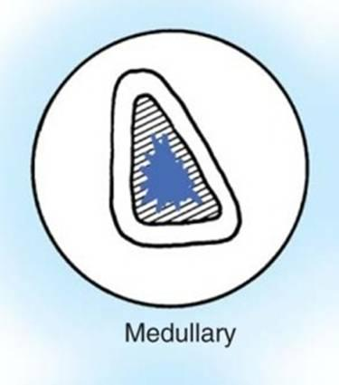
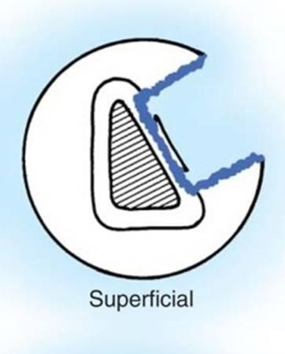
Cierny-Mader Classification

Slide 14
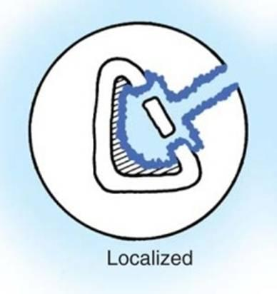
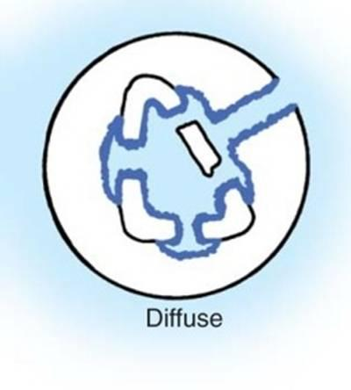

Slide 15
Cierny-Mader Classification | Anatomic Location
Stage 1 | Medullary
Stage 2 | Superficial
Stage 3 | Localized
Stage 4 | Diffuse

Slide 16
 | Host type
Type A | Normal
Type BL | Locally compromised
Type BS | Systemically compromised
Type C | Treatment is worse to the patient than infection

Slide 17
Associated conditions
Orthopedic manifestation
Septic arthritis
Abscess
Medical Conditions
Immunosuppression
Dialysis
IV drug use
Diabetes
Poor nutrition
Vascular disease

Slide 18
Osteomyelitis of special importance
Brodies abscess
Sclerotic osteomyelitis of garre
Tubercular osteomyelitis
(Ebnezer, 2012).

Slide 19
Questions ???

Slide 20
Summary
Osteomyelitis is a bone infection caused by pyogenic organisms. Staphylococcus aureus are the major causative microbes. Mode of spread entails haematogenous, contagious spread and direct inoculation. Major classification are acute, sub-acute and chronic osteomyelitis.

Slide 21
Reference
Ebnezer, J, (2012): Textbook of Orthopedics Fifth Edition:, Jaypee Brothers Medical Publishers (P) Ltd.
Duckworth, T, and Blundell, C.M, (2013) Orthopaedics and Fractures Fourth Edition:, Wiley-Blackwell publishers.
Shenoy, R.M, (2010), Essentials of Orthopedics, First Edition: Jaypee Brothers Medical Publishers (P) Ltd
www.https//:orthobullets.com

Slide 22
Assignment
Describe the following
Acute osteomyelitis
Chronic osteomyelitis
Group assignments
Source of information: library and internet

Slide 23
Thank you

Slide 24
Acute Osteomyelitis
This is a common condition and is usually caused by Staph. Pyogenes, but occasionally by other organisms, e.g. streptococcus, pneumococcus, salmonella and Escherichia coli
(Hamblen and Simpson, 2010)

Slide 25
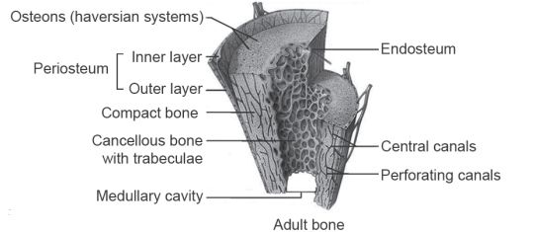

Slide 26
Pathology
The infection usually starts in the
vascular metaphysis which results in the formation of abscess.
The pus so formed finds its way
out through the area of least resistance.

Slide 27
Cont’d
The subperiosteal abscess so developed will
either spread through the soft tissues
or drain to the outside by
forming a sinus breaking the skin
or it will percolate down towards
the diaphysis between the periosteum

Slide 28
Cont’d
and the cortex and enter the shaft
through the widened haversian pores due
to anoxia.
The growth plate limits spread to the joint.

Slide 29
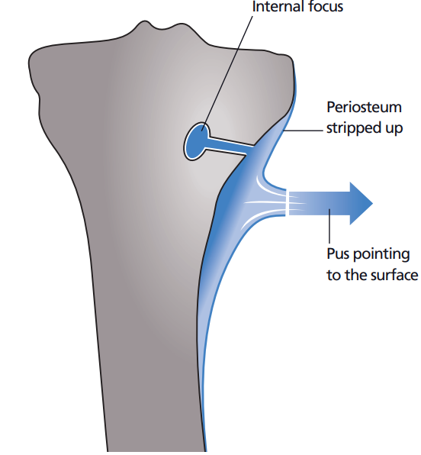

Slide 30
Cont’d
Common sites
Lower end of the femur
Upper end of the tibia
End of the humerus
Radius and ulna
The vertebral bodies
(Hamblen and Simpson, 2010)

Slide 31
Why the metaphysis of a long bone?

Slide 32
Cont’d
It is said to get entrapped in this region because of the following reasons:
Metaphysis is more vascular.
Most of the arteries are end arteries.
Vessels show a hairpin bend.
Lumen is of a narrower calibre.
Relative lack of phagocytosis
(Shenoy, 2010).

Slide 33
Clinical Features of Acute Osteomyelitis
Fever, associated with profuse sweating, chills and rigors.
Pain , localized to metaphysis classically
Local swelling, often associated with joint stiffness
Tenderness, localized

Slide 34
Cont’d
Increased pulse
Local erythema
Limitation of movement (state of pseudoparalysis)
Oedema and pus ;a fluctuant mass,
(Duckworth and Blundell, 2013)

Slide 35
Investigations
Laboratory
Haemoglobin; Normal or decreased
ESR; elevated
CRP; elevated
WBCs Neutrophils Increased
Blood culture; positive for the organism
(www.orthobullets.com, 2022)

Slide 36
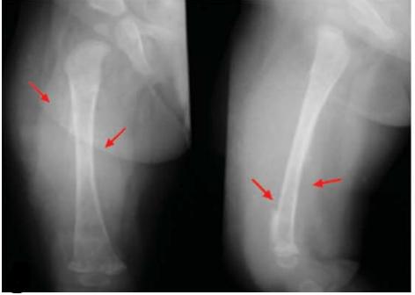
Radiological
X-rays; bone resorption and a periosteal reaction

Slide 37
Cont’d
Bone scan,
MRI
CT
Bone scan
Sinograms
(Ebnezer, 2012).

Slide 38
Treatment
Aim of the treatment is to
eradicate the infection and prevent the
development of chronic osteomyelitis.
(Shenoy, 2010).

Slide 39
Antibiotics therapy in osteomyelitis
a) Antibiotics: Broad spectrum antibiotics
Penicillins
B-lactamase inhibitors
Cephalosporins
Parenteral IV antibiotics for 4-6 weeks
Oral antibiotics for 2-4 weeks
(Ebnezer, 2012).

Slide 40
Cont’d
b) Drainage of pus: The pus inside
the bone (bone abscess) has to be
drained.
The drainage procedure is known as decompression.

Slide 41
Cont’d
c) Control of infection: Locally the method
of continuous irrigation and suction

Slide 42
Cont’d
d) Immobilization: The limb is always immobilized and protected with the help
of external splint.

Slide 43
Cont’d
e) Eradication of infection: Administration of prolonged, adequate and appropriate antibiotic therapy eradicates the focus of infection.

Slide 44
Complications
Septicaemia and pyemia
Septic arthritis
Chronic osteomyelitis
Pathological fractures
Growth disturbances
(Ebnezer, 2012).

Slide 45
Differential Diagnosis
Acute Septic Arthritis
Scurvy
Acute Anterior Poliomyelitis
Cellulitis
(Hamblen and Simpson, 2010)
Erysipelas
Erythema nodosum
Ewing’s sarcoma
Sickle cell anaemia

Slide 46
Prognosis
Age: If children.
Agent: If S. aureus.
Site: If nearer to trunk.
Poor prognosis in patients with major nutritional or systemic disorders

Slide 48
Chronic Osteomyelitis
Chronic osteomyelitis can arise from any one of the following ways:
Sequel of acute osteomyelitis
Following compound fractures
Following surgery on bones and joints

Slide 49
Cont’d
Chronic from the beginning (e.g. tuberculosis, syphilis, Brodie’s abscess)
Anaerobic organisms (sclerosing osteomyelitis of Garre)
Fungal osteomyelitis

Slide 50
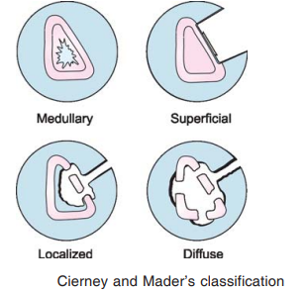
Classification

Slide 51
Type 1:medullary
Disease is limited to the medullary cavity.
It is often caused by a solitary organism.

Slide 52
Type 2: superficial
There is involvement of the cortex.
The cause is often an adjacent soft
tissue infection.
Exposed, infected outer necrotic surface of
bone is observed at the base of a soft tissue wound.
Local ischaemia is seen.

Slide 53
Type 3: localized
There may be involvement of both the
medulla and cortex, but the bone generally
remains stable, as the infection does
not involve its entire diameter.

Slide 54
Type 4: diffuse
Disease is extensive.
It may occur on both sides of a
non-union or a joint.
There is involvement of the entire
thickness of the bone, with loss of stability

Slide 55
Cont’d
A segment of dead bone is termed a sequestrum.
In chronic cases this may be walled off
with surrounding live new bone, termed an involucrum.
There may be a connecting sinus between
the sequestrum and the skin surface.

Slide 56
Pathogenesis
Periosteal elevation deprives the underlying cortical bone of blood supply leading to
necrotic bone (sequestrum)
Sequestrum
The necrotic bone which has become walled off from its blood supply and can present as a nidus for chronic osteomyelitis

Slide 57
Cont’d
An outer layer of new bone is
formed by the periosteum (involucrum)
Involucrum
A layer of new bone growth outside
existing bone seen in osteomyelitis

Slide 58
Types of Sequestrum
Ivory: syphilitic osteomyelitis
Black: fungal osteomyelitis
Sandy or rice grain: tuberculosis
Diaphyseal: children
Crown: amputation
Ring: infected pin track
Feathery: tuberculosis involving the ribs
(Shenoy, 2010).

Slide 59
Clinical Features
General
Fever
Tachycardia
Hypotension
Erythema
Tenderness
Edema
Limitation of movement
(Hamblen and Simpson, 2010)

Slide 60
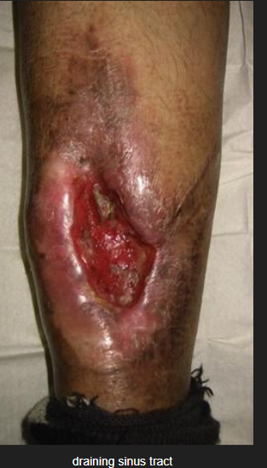
Local
Persistent discharging sinus fixed to the bone.

Slide 61
Cont’d
Bony thickening
Bony irregularity
Bony tenderness may be present.
Deformity may be present.
Limb length discrepancy may be present
(Shenoy, 2010).

Slide 62
Investigations
Laboratory
Hb
ESR
CRP
Blood cultures
Microbiology, sinus tract cultures $ culture of bone
Histology
(www.orthobullets.com, 2022)

Slide 63
Radiographs
Orthogonal plain radiographs of the affected extremity
CT
MRI
Nuclear medicine
Technetium bone scan
Gallium scan
(www.orthobullets.com, 2022)

Slide 64
Radiological features
Bony irregularity
Increased density
Presence of cavities
Presence of Sequestrum
Presence of involucrum
(Ebnezer, 2012).

Slide 65
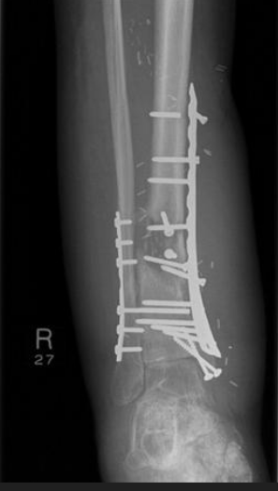

Slide 66
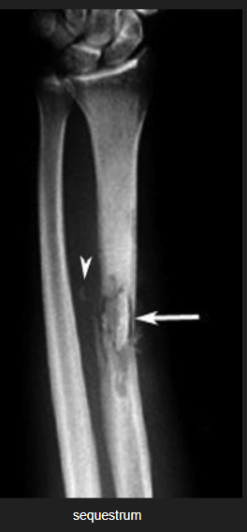

Slide 67
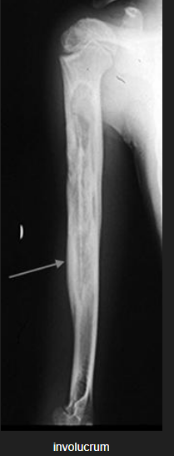

Slide 68
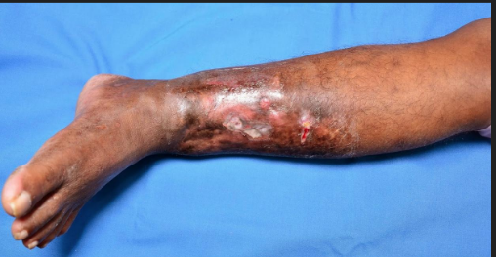

Slide 69
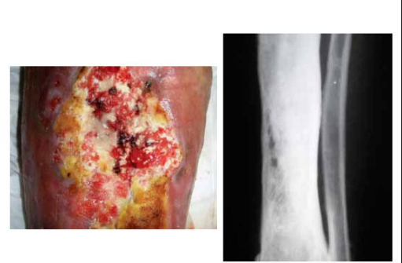

Slide 70
Management
Goal: Eradication of the infection by
achieving a viable and vascular environment.

Slide 71
Non-operative Treatment
Suppressive antibiotics
Hyperbaric oxygen therapy
(www.orthobullets.com, 2022)

Slide 72
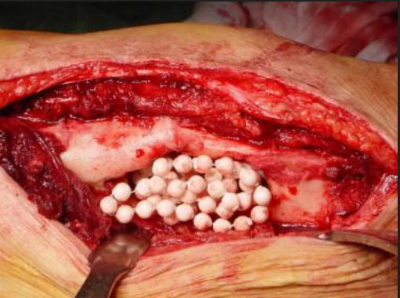
Operative treatment
Irrigation and debridement followed by organism specific antibiotics
Antibiotic-impregnated acrylic beads (PMMA)

Slide 73
Cont’d
Sequestrectomy and saucerization
External fixation

Slide 74
Complications
Pathological fracture
Growth disturbances
Deformities
Amyloidosis
Epithelioma
(Shenoy, 2010).
Persistence or extension of infection
Amputation
Sepsis
Malignant transformation

Slide 75
Questions ???

Slide 76
Summary
It is pivotal to understand the definitions, predisposing factors, risk factors, pathogenesis, clinical features, investigations management, complications, differential diagnosis and prognosis in osteomyelitis.

Slide 77
Reference
Ebnezer, J, (2012): Textbook of Orthopedics Fifth Edition:, Jaypee Brothers Medical Publishers (P) Ltd.
Duckworth, T, and Blundell, C.M, (2013) Orthopaedics and Fractures Fourth Edition:, Wiley-Blackwell publishers.
Shenoy, R.M, (2010), Essentials of Orthopedics, First Edition: Jaypee Brothers Medical Publishers (P) Ltd
www.https//:orthobullets.com
Hamblen. D.L, A Simpson, H.W, (2010) Adams’s Outline of Orthopaedics: Fourteenth Edition, ©Churchill Livingstone Elsevier.

Slide 78
Assignment
Discuss the following:
Brodies abscess
Sclerotic osteomyelitis of garre
Tubercular osteomyelitis
Individual assignments
Source of information: library and internet

Slide 79
Thank you

Slide 80
Osteomyelitis Of Special Importance
Brodies abscess
Sclerotic osteomyelitis of garre
Tubercular osteomyelitis

Slide 81
BRODIE’S ABSCESS
It was described by Sir Benjamin Brodie
a surgeon in St George’s Hospital, London,
in 1832.
He came to a conclusion of a
subacute infection from a specimen of an
amputated limb which he did for intractable pain.

Slide 82
Cont’d
He observed a cavity filled with
dark colored thick pus and the wall
of the cavity consisted of hard
white bone.

Slide 83
Cont’d
Brodie’s abscess is a localized form
of chronic osteomyelitis, involves metaphyseal
and epiphyseal area, and is common
in young adults

Slide 84
Clinical Presentation
Intermittent pain of long duration
Local tenderness
Mild to moderate pain.
A hard swelling may be appreciated

Slide 85
Etiology
Causative organism is low virulence Staph. Aureus
in 50 percent of the cases.

Slide 86
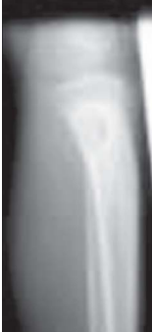
Radiograph
Usually, a cavity with a rim of
sclerotic bone is seen at the
metaphysioepiphyseal junction.

Slide 87
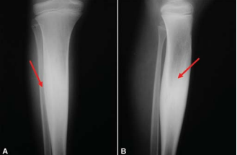

Slide 88
Cont'd
A cystic lesion with surrounding sclerotic bon.
Some instances onion skin periosteal bone resembling Ewing’s
Cortical hyperostosis resembling osteoid osteoma

Slide 89
Lab
Biopsy

Slide 90
Treatment
Appropriate antibiotics
Curettage
Bone grafting and the wound is
loosely closed over a drain.

Slide 91
Cont'd
Surgery of draining the cavity under
antibiotic cover is considered only when
nonoperative treatment fails.

Slide 92
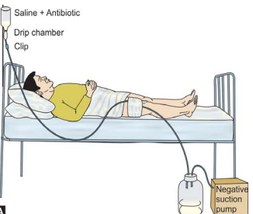

Slide 93
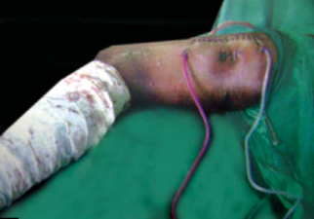

Slide 94
SCLEROTIC OSTEOMYELITIS OF GARRE
This is a chronic or subacute form
of chronic osteomyelitis.
It is a nonsuppurative ossifying periostitis which occurs as a response to low
grade infection and ensuing irritation.
Notes:
There is no abscess, only a diffuse enlargement of the bone
at the affected site – usually the diaphysis of one
of the tubular bones or the mandible.

Slide 95
Cont’d
It is common in children and young adults.
It affects the superiosteal region and
the bone is thickened.

Slide 96
Cont’d
Though the exact cause idiopathic, it
could be due to low-grade anaerobic infection.
A secondary infection may occur at a distant site.

Slide 97
Clinical Features
Intermittent pain
Swelling
Tenderness
Low-grade fever

Slide 98
Investigations
Radiographs show expanded bone with generalized sclerosis.
Increased bone density and cortical
thickening
; in some cases the marrow cavity

Slide 99
Cont'd
Bone scan
PET scan
ESR is usually raised.
Biopsy is definitive and confirmatory.

Slide 100
Treatment
Treatment consists of fenestration(Opening
in the surface of an organ) of
sclerotic bone and appropriate antibiotics
should be given.

Slide 101
Tubercular Osteomyelitis
The onset of tuberculosis foci
is within the bone.

Slide 102
Pathology
Deficient anastomosis of the osseous arteries
in childhood, and thrombosis caused
by tubercular pathology may lead
to sequestration of a major part
of the diaphysis.

Slide 103
Clinical Features
Pain
Swelling is warm and tender
There may be a cold abscess
or sinus formation or an ulcer.
Enlargement of regional lymph nodes.

Slide 104
Radiographs
Plain radiographs can be normal in early infection and when abnormal can show:
Eccentric lytic lesion with minimal or
no periosteal reaction
A cortical defect may be present
Local osteopenia

Slide 105
Cont’d
Radiographs cavities
Little sclerosis (honeycomb appearance)
Soft tissue swelling of anteroposterior and
lateral views of the affected part
show irregular swelling

Slide 106
Differential diagnosis
Chronic Pyogenic Osteomyelitis
Brodie Abscess
Bone Tumor

Slide 107
Swelling With Multiple Discharging Sinus
Over mandible (or head - neck region) – Actinomycosis
On Foot – Madura foot/Maduromycosis
Paronychia – infection of nail bed Staph, or S.Aureus

Slide 108
Cont’d
Felon – infection of pulp space, S.Aureus, most commonly affects thumb > Index finger
Infectious Tenosynovitis–Staph Aureus.

Slide 109
THE END
THANK YOU

